Slide 1
SR-194 EXTENSION / EXIT 39
MANDATORY PRE-PROPOSAL
MEETING
5-20-2022
MAKE SURE TO SIGN-IN

Slide 2
TDOT PROJECT TEAM
Steve Sellers l Blue Oval City Program Manager
615-741-0786 steve.sellers@tn.gov
Brandon Akins, P.E. | Civil Engineering Manager 2
901-537-1178 Brandon.Akins@tn.gov
James Kelley, P.E.| Director Project Management
615-253-7604 James.D.Kelley@tn.gov
TDOT Representation
Geotechnical, Environmental, Traffic, Design, Survey, Operations,
Right of Way, Structures, many others……

Slide 3
DESIGN PROJECT TEAM
Brian Trotter, P.E., CPESC l HDR Project Manager
Ben Campbell, P.E. | HDR Deputy Project Manager
Dan McGaha, P.E.| HDR Roadway Design Lead
Carter Bearden, P.E.| HDR Structures Design Lead
Devin Chittenden, P.E.| HDR Geotechnical Design Lead

Slide 4
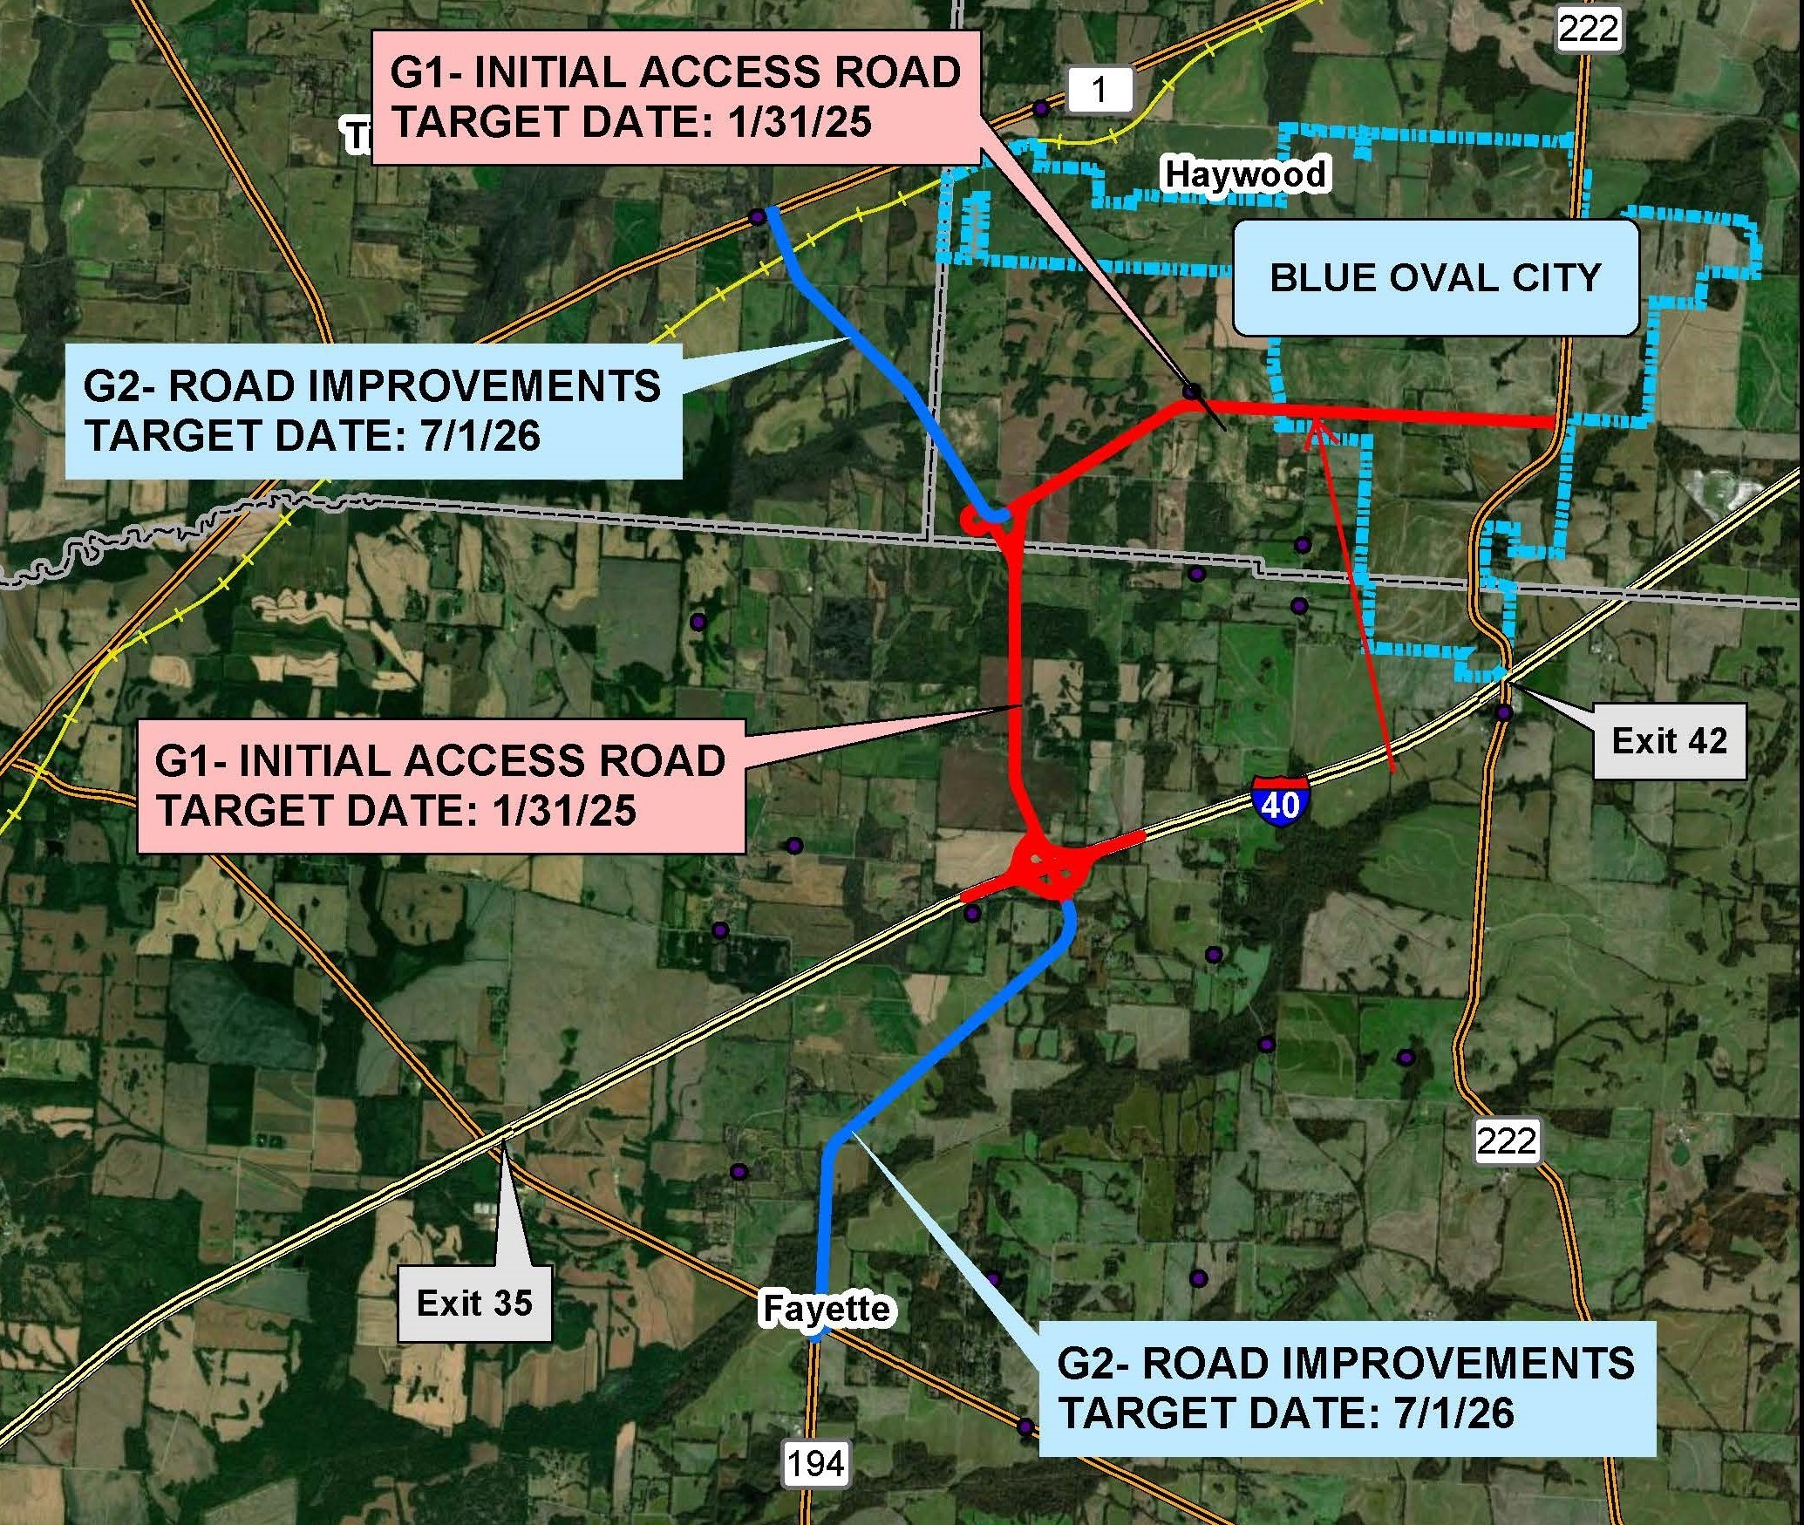
Overview
G1 Includes New Interchange at MM 39, 2 miles of SR-194 to northern Interchange, and 3.6 miles of Connector Road to SR-222. G1 will be 4 lane median divided roadway section to the boundary of the MegaSite.
G2 Includes 3.5 miles of SR-194 from SR-59 to new Interchange at I-40 and 2.3 miles of SR-194 to SR-1. G2 will be 2 lane rural roadway section.

Slide 5
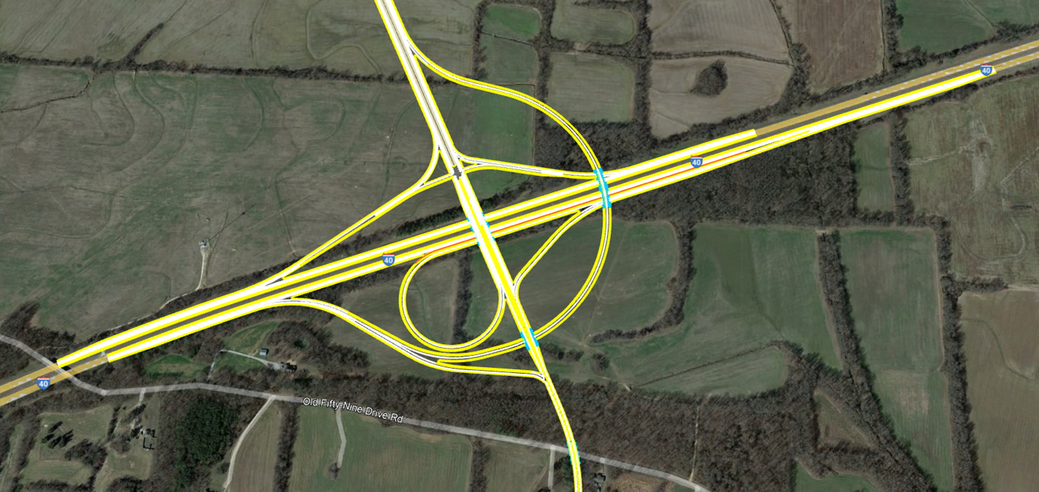
TDOT – CMGC05 SR-194 Extension / Exit 39

Slide 6
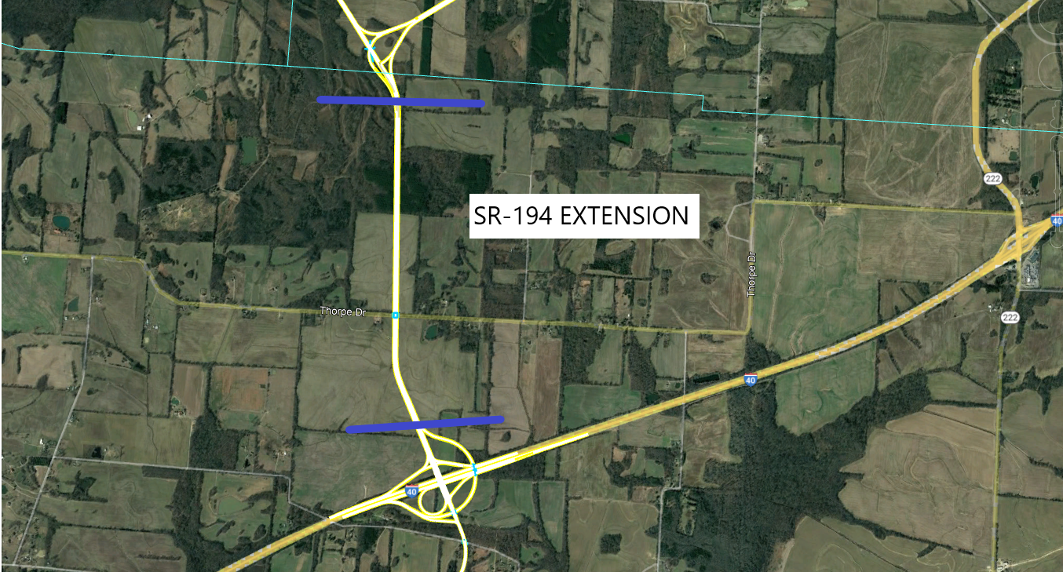
TDOT – CMGC05 SR-194 Extension / Exit 39

Slide 7
TDOT – CMGC05 SR-194 Extension / Exit 39
Proposed SR-194 extension between proposed Exit 39 at I-40 and the Northern Connector Interchange - This portion of the proposed SR-194 extension would consist of four 12-foot travel lanes (two lanes in each direction), 12-foot shoulders on either side of the roadway and a 24-foot inside median separating the travel lanes. The design speed would be 55 mph. Full access control would be provided for this portion of the project. A bridge would be constructed over Thorpe Drive to allow continued access by local traffic.

Slide 8
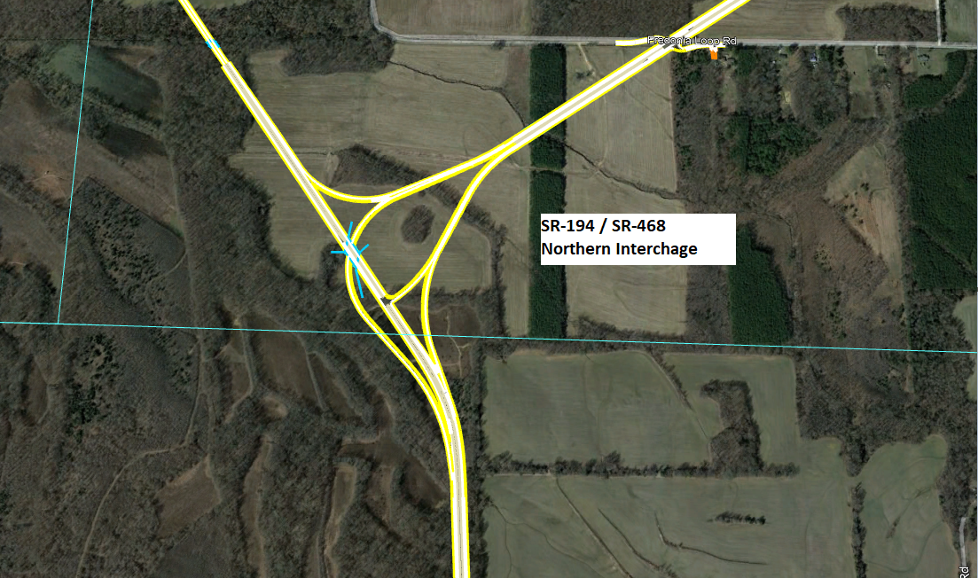
TDOT – CMGC05 SR-194 Extension / Exit 39
Northern Connector Interchange - A partial directional interchange is proposed to be constructed at the intersection of the proposed SR-194 extension and the proposed SR-468 Connector. The proposed SR-194 extension would bridge over the proposed SR-468 connector. Connection points to the proposed SR-194 extension to the south and north would be constructed at-grade.
SR-194 EXT. / SR-468
Northern Interchange

Slide 9
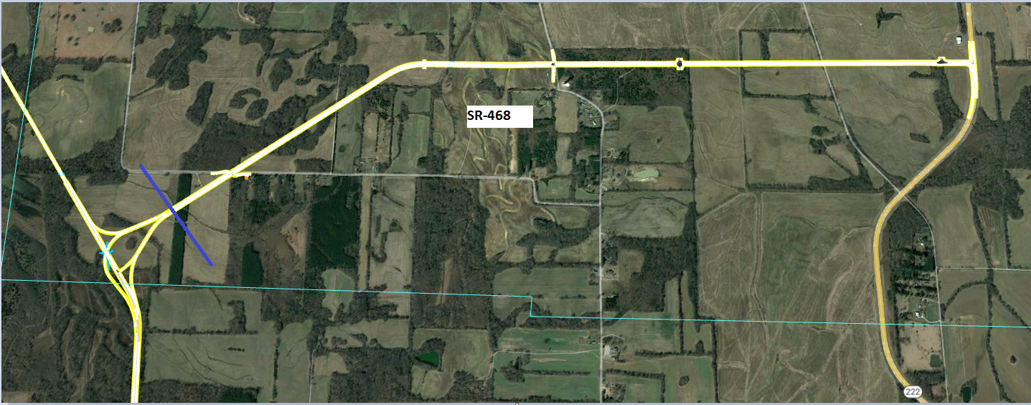
TDOT – CMGC05 SR-194 Extension / Exit 39

Slide 10
TDOT – CMGC05 SR-194 Extension / Exit 39
Proposed SR-468 - This portion of the project would consist of four 12-foot travel lanes (two lanes in each direction) separated by an 18-foot median (14-foot raised median and two-foot inside shoulders) and 12-foot outside shoulders. The proposed SR-468 would be a limited access-controlled facility to the MegaSite boundary. From the boundary of the MegaSite to the intersection of SR-222, the road would consist of four 12-foot travel lanes (two lanes in each direction) separated by a 12-foot two-way center turn lane. At the intersection of the SR-468 and SR-222 a signalized intersection is proposed.

Slide 11
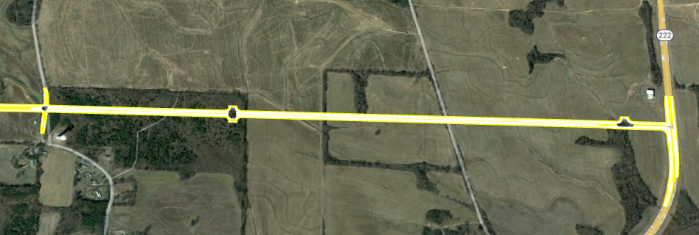
TDOT – CMGC05 SR-194 Extension / Exit 39

Slide 12
PROJECT PROGRESS
IAR – In Progress
Technical Studies – In progress (Archaeology, Historic, Air, Noise, Hazmat, & Ecology)
NEPA – In progress
ROW – In progress
Design – Concepts for I-40 Interchange, Line and Grade plans, and coordination with Environmental (Utilizing Open Roads-Bentley)
Utilities – Utility early notice

Slide 13
PROJECT SCHEDULE
Environmental Document Progressing coordinating with agencies
*Dates subject to change

Slide 14
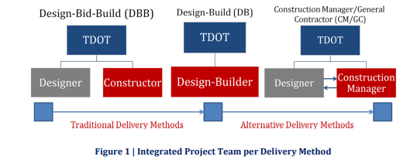
CMGC
Tennessee Code Annotated §54‐1‐501 through §54‐1‐508 Construction Manager/General Contractor Services allows the department authority to use CM/GC.
CM/GC utilizes an Integrated Project Team consisting of three components.
Owner (TDOT)
Designer (HDR, Inc.)
Two‐phase Contract with a General Contractor
Phase 1: Construction Management – consulting contract to help with design
Phase 2: General Contracting – contract to build the project
Construction Manager/General Contractor (CM/GC) is a contracting method that involves a Contractor in the design and construction phases of the project. The intent is to form an integrated project team with TDOT, a Design Consultant, and a Contractor.

Slide 15
CMGC
The goals of this integrated project team are to mitigate risk, improve the construction schedule, streamline the design process, and reduce costs.
Contractor’s Role
Evaluate the constructability of the design plans
Reduce risk in all phases of project development
Provide innovative approaches to meet budget goals.

Slide 16
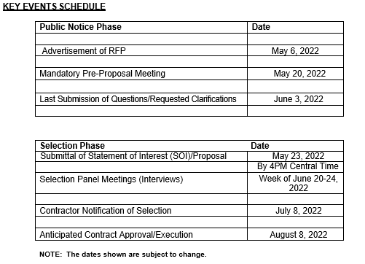
CMGC-RFP

Slide 17
CMGC-RFP
CM/GC Procurement Process
Attend Mandatory Pre-Proposal Meeting
Minimum Proposal Requirements – RFP
Bonding Capacity, Pre-qualify, etc.
Proposal General Information - RFP
Multiple proposals from a single Proposer will not be considered.
Any proposal received by TDOT after the time specified in the proposal shall be considered late and no late proposals will be accepted for the project.
Oral Interview meetings with the selection panel and further evaluated based on criteria outlined in the Department’s RFP.
Numerical ranking and selection of the most qualified responsive Proposer will then occur on the corresponding evaluation forms in the RFP.

Slide 18
TDOT – CMGC05 SR-194 Extension / Exit 39
QUESTIONS
?

